Slide 1


A glimpse of the future
From managing process to maximizing impact
Tier 2 Committee Visions for the future of the agency​
Supported by the Transformation Unit (OCS) & Business Planning (BPPD)​
May 2025

Slide 2
Objective
SMC approval of the overall direction for the agency
This will be a critical consideration for the next Agency Strategic Plan
SMC approval of the Tier 2 visions
This will be the foundation of the 2025-26 Tier 2 committee objectives

Slide 3
Why Now?
A Pivotal Moment for Statistics Canada
We are at a critical inflection point—where the world is changing, and so must we.
Why Now?
Because if we want to keep mattering tomorrow, we must redefine how we deliver value today. This is our moment to choose bold change—to leverage the transformational efforts already underway and build a vision of the future that keeps Statistics Canada essential, relevant, and resilient.
External Pressures:
A faster, more complex world – The pace of change is accelerating, and the questions we’re being asked are more urgent and nuanced than ever.
Eroding trust in institutions – Public confidence is increasingly fragile, amplified by misinformation and disinformation.
Rising demand for timely, relevant insights – Canadians and decision-makers expect faster, clearer answers—with no compromise on quality.
Shrinking government budgets – We’re expected to deliver more, and better, with fewer resources
Internal Catalysts
New Chief Statistician – A change in leadership brings an opportunity to reimagine our future and reassert our value.
Refocus on our core business – We are zeroing in on what we do best: producing high-quality, trusted, and impactful data
Aging systems and declining response rates – Foundational elements of our work are under strain and need renewal.

Slide 4
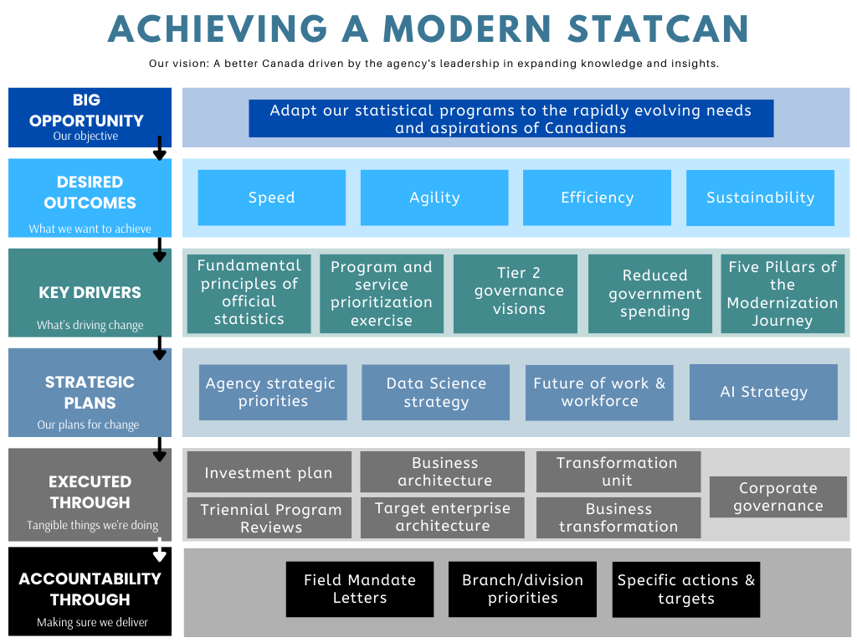
Our Direction:
From managing process
to maximizing impact
We’ve shown that Statistics Canada delivers—especially when it matters most. Now, we’re taking the next step: building on that legacy to become a more agile, efficient, and responsive organization—able to move at speed, adapt to change, and deliver sustainable value in a complex and evolving world.
This isn’t just about new tools—it’s about shifting our focus from managing process to maximizing impact. Empowering our experts. Deepening our insights. Strengthening our partnerships.
The Tier 2 committee visions presented today reflect this shift—and they sit at the heart of our broader transformation model. They help bring to life our shared objective:
Adapt our statistical programs to the evolving needs and aspirations of Canadians.

Slide 5
Key priorities of the future state
End-to-End Process Automation with Minimal Manual Intervention
01
Automated, AI-powered data pipelines—from acquisition to dissemination— reduce manual effort, increase speed and quality, and enable real-time responsiveness across all stages of the statistical business process.
Employee input focuses on higher value work, innovation, and interpretation, not execution.
Surveys as a last resort, not first response
02
Exploiting existing data holdings is the first response for new/existing data needs. Admin data and alternative data is the second response for new/existing data needs. Surveys are only used if necessary and are optimized dynamically based on cost-benefit analysis.
Designing, rendering and fielding a questionnaire is done using AI and takes no more than X time
Searchable, Usable, Actionable Data Assets
03
All data and metadata are standardized, richly described, and machine-actionable—built for interoperability and reuse across tools, systems, and organizations.
Discovery, understanding, and use are seamless for all types of users—whether human or machine—through APIs, metadata tagging, and open formats.
Our data ecosystem empowers internal and external users to find, consume, and transform data into new insights, products, and services.
Modular, Reusable Architecture and Tools & services
04
The organization has modular tools and microservices to increase agility, maintainability, and reuse across programs.
Business areas are empowered to prototype and develop smart solutions using supported self-service environments, with guardrails and shared libraries.
Open-source tools are the default, and employees openly share their code.
A Modern, Insight-Driven Workforce
05
Analysts and researchers focus on value-add insight, not operational tasks—spending more time understanding context, building relationships, and generating actionable analysis.
Teams are curious, agile, and versatile—fluent in open-source tools, data science methods, and collaborative problem-solving across disciplines.
Analysts work in multidisciplinary teams that integrate design, technology, and subject matter expertise to deliver user-centered solutions.
Decisions are made by clearly designated owners—not by group consensus—but they are communicated and understood by those affected

Slide 6
Next steps
What you’ve seen today is more than a collection of committee visions—it’s a shared picture of the organization we want to become. A faster, more flexible, and more connected Statistics Canada—one that leads with insight, empowers its people, and meets the needs of a changing world. This is a moment to build on the momentum we already have, and to commit to delivering—not just planning—for the future.
To ensure we deliver on the vision presented today:
The Business Planning team will return to EMC with a focused execution proposal to address execution gaps. Once approved, the recommendation is to tie the execution to executive PMAs.
The Transformation Unit will link structure, processes, data and technology with the organization’s strategic goals and objectives.
The visions presented today will be shared with all executives during the Strategic Alignment Session to ensure broad engagement.
These visions will directly inform Tier 2 governance priorities and annual objectives, anchoring transformation in leadership accountability.

Slide 7
GSBPM Roadmap Data In

Slide 8
Vision | Strategic Priorities | Action Plan (and implicated GSBPM steps) 1.4 Identify concepts / 1.5 Check Data Availability 2.4 Design Data Collection 3.1 R-use or build collection instruments 4.1 Create frame and select sample / 4.2 Set up collection / 4.3 Run collection / 4.4 Finalise collection
Subject matter centres are able to respond to new data requirements by designing and implementing statistical programs more quickly and at lower cost Tradeoffs between statistical quality and cost are fully-informed and evidence-based | Accountabilities and roles and responsibilities related to data acquisition are defined based on function and are understood across the organization | Clear delineation sponsor (subject matter) roles and accountabilities, based on the minimum requirement that sponsors / subject matter are responsible for specification and certification (1.4, 1.5, 3.1, 4.4) Full transfer of accountabilities for activities and functions related to data acquisition and collection to suppliers Elimination of ‘dual accountabilities’ which can lead to disincentives to speed and statistical rigour
 | Existing data holding are exploited to the greatest extent possible. New data needs are addressed to the greatest extent possible through administrative and alternative data, with household and business surveys being conducted only when necessary. The length and response burden of questionnaires is optimised to balance respondent experience, data quality and information needs. | (Activities outside the scope of Data In Committee, with some pre-collection decision processes being informed by SPAC and governed by Field 8 – Field 5 Committee) Creation of a “centre of expertise” which works with subject matter specialists to expedite the negotiation and acquisition of administrative and alternative data Pilot projects to enable partners to clean data using AI, prior to its ingestion by Statistics Canada (e.g. Cancer Registry) (2.4)
 | The time and effort involved in acquiring administrative and alternative data is significantly reduced Issues involved in the retention of administrative and alternative data (including ongoing acquisition costs, vulnerability to cost increases and storage costs) are planned for prior to acquisition.

Slide 9
Vision | Strategic Priorities | Action Plan (and implicated GSBPM steps) 1.4 Identify concepts / 1.5 Check Data Availability 2.4 Design Data Collection 3.1 R-use or build collection instruments 4.1 Create frame and select sample / 4.2 Set up collection / 4.3 Run collection / 4.4 Finalise collection
Subject matter centres are able to respond to new data requirements by designing and implementing statistical programs more quickly and at lower cost Tradeoffs between statistical quality and cost are fully-informed and evidence-based | The time and effort involved in designing, rendering and fielding a questionnaire are significantly reduced. | Assignment of full accountability for rendering to a single centre in Field 7 (3.1) Design and implementation of questionnaire specification and rendering business processes which take advantage of AI (3.1) Enforcement of pre-determined timeliness standards (for example, no more than x weeks between subject matter providing specifications and the start of collection) (3.1) Reform of questionnaire building and prescription policies and directives (3.1)
 | Manual effort involved in ‘shepherding’ data from pre-collection, collection and post-collection is eliminated to the greatest extent possible. | Alignment of pre-collection (frame maintenance and sampling) and post-collection (processes and financial analysis) business processes and systems and ‘pipelines’ to facilitate maximum automation and minimize human interventions and programmatic patches (2.4)
 | Survey collection efforts are adjusted in real time, to maximise tradeoffs between collection costs and data quality | Modernisation of collection systems and platforms to include the use AI and other advanced methods to adjust collection efforts and re-assign cases in real time. (4.3) Implementation of ‘one workforce’ model for collection (4.2 and 4.3) Development and implementation into production of a range of sampling options, including person-based sampling (2.4)
 | Survey collection strategies are continually evaluated and adjusted | Investments in world leading collection research (4.4) Implementation of experimentation mechanisms, including LFS Innovation Panel, to measure ‘what works’ (4.4) Implementation of forums to foster a culture of constant improvement and statistical rigour (4.4)

Slide 10
GSBPM Roadmap Data Out

Slide 11
Business Vision
GSBPM Step: Dissemination
Business Vision: Transform our data dissemination approach by becoming a modern, digital-first statistical agency. Prioritize automation, metadata enrichment, and open, machine-readable data structures to ensure our information is accessible, discoverable, and actionable for all user groups—including both sophisticated researchers and new AI-powered query tools. Our goal is to empower users to get the data they need by themselves, while making our services more efficient, accessible and visible for those who require a more customized approach.
Key changes required to reach the vision: Expanded Digital Dissemination: Shift focus from static web publishing to dynamic, interactive, and API-driven platforms for more accessible and real-time data engagement. Automation of Core Processes: Automate production and dissemination of data products (including data tables and PUMFs), improving speed, accuracy, and resource efficiency. Metadata-First Approach: Implement comprehensive metadata standards and tagging, enabling external tools like ChatGPT, Gemini, and other AI agents to accurately discover and extract relevant data. Clear User Segmentation: Redesign websites as specialized platforms primarily targeting advanced users, like researchers and policymakers, with the understanding that the general public will increasingly access our data through third-party AI interfaces. Having options for users that need more support. Mandatory Open File Formats: Standardize output formats (such as SDMX) to ensure compatibility, interoperability, and ease of use for downstream consumption and integration. Streamline Publication Workflows: Streamline and automate the end-to-end publication process to reduce friction, duplication, improve consistency, and better support rapid content updates. Reevaluate Data Visualization Investments: Focus less on proprietary visualizations for public users, recognizing that users will generate tailored outputs via AI tools.

Slide 12
Business Vision (continued)
GSBPM Step: Dissemination
Value to Stakeholders / Users: Increased Accessibility: Users, whether individuals, organizations, or AI agents, will access data seamlessly in their preferred format or interface, reducing friction and democratizing insight. Enhanced Relevancy: By ensuring our data is easily findable and usable by emerging technologies, we safeguard our role as an authoritative data provider in a rapidly evolving information ecosystem and counter disinformation. Improved Stakeholder Satisfaction: Advanced users (e.g., researchers, policymakers) benefit from specialized, high-value interfaces and standardized, robust data offerings. Operational Efficiency: Automation and streamlining of dissemination reduce manual workload, allowing staff to focus on higher-value activities. Future Preparedness: Early adoption of machine-readable standards and automated processes ensures organizational adaptability and resiliency in the AI-driven future.

Slide 13
Key Opportunities
Key Business Process | Current State | Proposed Change (tactic, lever) | Expected Impact
Public Use Microdata files | PUMFs are downloadable now from our website however many subject matter areas find it too labour intensive and expensive to create them. | Make PUMFs mandatory, use automated methods for creation of PUMFs | Providing users with more microdata level information as we are the authoritative source. Automation and streamlining of dissemination reduce manual workload, allowing staff to focus on higher-value activities.
Dissemination of statistical and analytical outputs | We create multiple products on the same topic such as having an infographic, video, article and a Daily. We also create data tables with a data visualization on the same information. | Discuss the type of product to disseminate before it gets to the end of the GSBPM process. Not all projects require a data visualization for example as users will do it themselves. | Reduction of duplication will help our search engine. It will be easier for users, whether individuals, organizations, or AI agents, to find what they’re looking for. We can also increase the impact of each release by reducing confusion.
Machine readable outputs | We only have 1 API right now (CODR). The website is too segmented for our own search engine and our web architecture is not optimized for machine learning. | Better and more robust API platforms for both data and metadata. Shift focus to dynamic, interactive, and API-driven platforms for more accessible and real-time data engagement since the general public will increasingly access our data through third-party AI interfaces | By ensuring our data is easily findable and usable by emerging technologies, we safeguard our role as an authoritative data provider in a rapidly evolving information ecosystem and counter disinformation.
Client Service | Client service is fragmented as it’s provided by different groups across the agency. We don’t always have clear service standards, a defined product line or a coherent strategy. | Centralize and standardize client services across divisions with the goal of reducing the number of layers between the client and the data. Offer a single point of entry and make our services more visible by engaging with users proactively. | As some clients won’t be able to find what they need online even after we’ve improved outputs, we need a complementary service offering with a renewed focus on consistency and high quality. We should aim to deliver value-added services that will widen and diversify our client base, increase our impact and meet cross-cutting needs.

Slide 14
GSBPM Roadmap Data and Information Governance and Stewardship

Slide 15
Business Vision
GSBPM Step: Collect/Process/Analyse/Disseminate
Business Vision: Integrate AI, ML, and other advanced technologies into the Generic Statistical Business Process Model (GSBPM) to enhance efficiency, accuracy, and responsiveness in statistical processes. By leveraging these for automated data collection, processing, analysis, dissemination, process optimization, and quality management, and incorporating robust standards and metadata management, we aim to create a seamless, high-quality, and adaptive statistical environment that meets the evolving needs of stakeholders.
Key changes required to reach the vision: Incorporate AI agents capable of interpreting data-sharing agreements, executing governance policies dynamically (e.g., privacy, retention, classification), and mediating context-aware access based on metadata, provenance, and purpose. The governance model is metadata-first: classification, policy, and access rules are machine-actionable, discoverable, and versioned. Shift from system access to data access will allow better scalability and security of data holdings emphasize modular design using microservices for scalable, reusable components, and a hybrid development strategy combining business-led and IT-led initiatives Implement Infrastructure to support the orchestration of Events to Trigger processing (Automation versus Manual to start) Shift from active data collection to a passive model for collection Incorporate further standardization throughout the collection process to support the remaining steps of GSBPM
Value to Stakeholders / Users: Enable AI through solid data foundations Statistical and data standards, and metadata management enable re-use and increased data usage Proper data governance and centralization will ensure consistency, accessibility, and quality, forming a solid foundation for innovation and decision-making adopting working in the open principles will foster transparency and international collaboration, with clear guidelines on code of practice, governance, and security Efficiencies in Processing Time and Elapse Time for both service provider and SMA, creating value to programs to shift focus to other higher value work activities/operations Assist in combating mis/disinformation

Slide 16
Key Opportunities
Key Business Process | Current State | Proposed Change (tactic, lever) | Expected Impact
Data Governance and Monitoring | Governance activities remain siloed and manual, constrained by centralized services and legacy systems. There is no real-time, decentralized mechanism for adaptive policy enforcement or automated data stewardship across jurisdictions. | Establish an agent-based system architecture composed of intelligent, autonomous software agents. These agents are embedded at the edge and coordinated via a lightweight Model Context Protocol (MCP), functioning as a decentralized policy interpreter and dispatcher. Each agent is capable of executing specialized tasks—such as metadata verification, data lineage tracking, stewardship validation, and anomaly detection—based on encoded governance policies and contextual awareness. Agents collaborate across jurisdictions to achieve emergent coherence without requiring a central authority. | Decentralized, adaptive monitoring of data quality and policy compliance. Real-time decision-making and issue resolution through agent negotiation and knowledge sharing. Reduced human oversight by automating lineage documentation, anomaly alerts, and stewardship verification. A scalable, modular governance infrastructure that aligns with asymmetric federalism.
Compliance with Governance, Privacy Regulations, and Policies | Manual access audits, ad hoc retention enforcement, and non-scalable data anonymization mechanisms prevail. Governance policies are interpreted and applied inconsistently, often relying on individual discretion and physical data management. | Embed AI agents within data workflows to interpret and enforce privacy, access, and retention policies in real time. These agents use contextual metadata and policy logic to flag unauthorized access, manage privacy-preserving tokens, and apply data minimization principles automatically. Retention and disposal workflows are AI-triggered, based on policy thresholds and data usage patterns. | Regulatory compliance becomes continuous, explainable, and machine-executed. Elimination of manual privacy enforcement burdens. AI-driven accountability mechanisms improve auditability and legal resilience.
Automated Data Classification | Classification is inconsistently applied, often reactive, and dependent on local taxonomies or manual review. There is no system-wide semantic alignment for classification across the NSS. | Activate MCP-linked AI classifiers trained on organizational taxonomies, jurisdictional norms, and contextual usage. These classifiers apply semantic labeling, metadata tagging, and sensitivity designations as data enters or moves across the system. The process is federated: local nodes maintain control, while classification standards are harmonized through shared governance ontologies. | Real-time, high-precision classification based on enterprise and regulatory standards. Improved interoperability and access control. Reduced risk of misclassification and enhanced data discoverability.
Standardization | Ad hoc use of standards throughout the organization at all GSBPM steps Lack of time and budget to align systems to standards which apply to legacy systems Processing doesn't allow for the introduction of these standards | Standard data formats, data models & concepts, data cataloguing, defined data domains to facilitate data stewardship, cloud storage solutions, medallion data architecture (lake house environment) | Prescribed standards applied to data, services, processes Improved data quality, findability, interoperability, and reusability

Slide 17
Concrete Actions
GSBPM Phase | Proposed Change (tactic, lever)
Data Collection/Acquisition | Ensure minimum metadata requirements are respected for every data collection/acquisition process Use AI to enhance the extraction of structured data from unstructured sources Ensure metadata to identify credible data sources to reduce mis/dis-information Automate recurring data acquisitions with external partners Use AI/ML to populate metadata repositories (fill gaps) and IM data tagging, at ingestion
Process | Expand use of SDMX throughout the data lifecycle process Leverage .STAT tools for data processing & analysis Implement an exemption process for non-compliance Amplify use of AI/ML to apply classification codes/standards Prescribe the use of data management tools (Aria/Colectica)
Analyse | Automate linkage of data from disparate sources to generate deeper insights Enhance data refinement to identify gold standard data, improving quality
Disseminate | Privacy-enhancing AI tools can automatically apply disclosure control, ensuring sensitive data protection before external sharing
Big G (Overarching) | Automate compliance measurement for standards/privacy/quality/metadata/TEA/… Customize TBS policies & strategies to individual departments Evergreening of governing instruments and strategies using AI to identify contradictions and flag required updates

Slide 18
GSBPM Roadmap BARB

Slide 19
Business Vision - Process
By 2030, Process (GSBPM 5.0) will operate infrastructure leveraging AI, ML, and advanced technologies to provide programs with rules for their Data Pipelines. Resilient, auditable, and adaptive workflows will produce timely, trustworthy, and reproducible statistical outputs across all subject-matter areas.
End-State Vision Statements (Concrete Outcomes):
GSBPM 5 sub-processes are orchestrated in modular, event-driven frameworks that are automated and version-controlled by design. Analysts are no longer required to manually intervene, clean or manipulate files.
AI-enabled modules handle 50% of manual interventions for activities such as classification, edits and imputation for administrative and survey data.
Every processing pipeline is auditable, reproducible, and deployable across subject-matter domains. Meta-data driven and standardization are default by design.
Data processing turnaround time has reduced by 50% across survey programs through automation and orchestration.
Microservices are used to manage each processing function (e.g. integrate data, edit, derive new variables, aggregate), with clear input/output standards across surveys and subject-matter areas.

Slide 20
Key Changes Required - Process
Culture Change: Emphasis on the need for the right people to handle technical aspects and the importance of standardizing data formats.
Data Integration: Focus on facilitating integration, with architecture and FAIR principles playing a key role.
Self-Service Platforms: Discussion on the role of self-service platforms and tools, making data pipelines transparent and user-friendly.
Wider adoption: Create role-based training for orchestration and automation (pipeline creation, usage and maintenance). Embed knowledge-sharing practices (community of practice).
Redefine roles and responsibilities: centralized versus decentralized systems, modular approaches, and standardization.
Agile governance: Current governance structure is rigid, risk averse and slow for iterative digital innovation.

Slide 21
Value to Stakeholders - Process
Faster Processing & Delivery: Real-time access to validate data supports faster insights.
Operational Efficiency: Automated, reusable components reduce duplication.
Greater Reproducibility & Transparency: Version-controlled workflows provide traceability.
Standardization: Uniformity in data processing enhances reliability.
Reduced manual interventions: Reproducible pipelines reduce process errors and streamline analytical operations.
Increased Trust & User Confidence: Transparent and systematic quality monitoring boosts data user confidence.

Slide 22
Business Vision - Analyse
By 2030, the Analyse (GSBPM 6.0) process will be modernized where analysts focus on delivering high-value outputs by leveraging their analytical expertise and subject matter knowledge. The Analyse process will use orchestration and embed Technology (AI and automation) throughout, supporting an event-driven creation of outputs, validation, user-friendly and robust disclosure control, and preparation of tables and reports for dissemination in a timely way.
End-State Vision Statements (Concrete Outcomes):
Analysts focus on value-added outputs such as interpretation and contextualization.
Reproducible, standardized analytical pipelines are the norm.
Publication preparation time is reduced by 50% leveraging AI and automation to facilitate output creation (e.g. Daily text) or validation.
Disclosure control outputs turnaround time is reduced by 50%.
FAIR-aligned data discovery platform enables better access and reuse. A searchable, metadata-driven data discovery platform is available to all analysts, enabling them to easily locate and access appropriate data sources.

Slide 23
Key Changes Required - Analyse
Automated Outputs: Implement AI-supported pipelines for auto-generated descriptive and exploratory analysis including daily write-ups, dashboards, and standardized analytical products.
Real-Time Analysis: Build infrastructure and tooling that enable real-time analytical workflows with intelligent validation and anomaly detection.
Privacy and Metadata Management: Use metadata repositories and FAIR standards for optimal integration into analytical pipelines.
Quality Assurance: Standardize pipelines with embedded validation rules.
Transparency and Trust in AI: Implement AI frameworks and ethical review processes to ensure human oversight, fairness, and trust in automated analysis.
Adapt hiring and redesign training: Redesign the Analysis 101 curriculum to proactively meet modern analytical profiles.
Data Access and Discovery: Develop a unified, searchable metadata-supported platform to find and access the best available data for analytical questions.

Slide 24
Value to Stakeholders – Analyse
More Timely and Relevant Outputs: Orchestrated and automated workflows accelerate end-to-end analysis providing relevant outputs faster.
Robust, scalable processes: Built-in validation, traceability, and cross-disciplinary input improve analytical robustness.
Improved Accessibility and Usability: FAIR-aligned data platforms make it easier to find, access, and use relevant data sources for confrontation.
Cost Efficiency: Automation and standardization reduce manual labour and operational overhead.
Innovation and Collaboration: Integrated workflows foster innovation, cross-functional teamwork, and faster uptake of new methods.
Maximized Data Value: Increased reuse and cross-functional application of existing data store.

Slide 25
GSBPM Roadmap Business Development

Slide 26
What is Business Development
Within StatCan, Business Development is defined as a program where employees outside of IT (programs, methodology, operations) are enabled to develop solutions using approved low-code/no-code platforms (e.g., PowerAutomate, PowerApps) and/or approved sets of tools within IT supported, security assessed, AI-enabled business platforms
"Business Development" replaces the concept of "Citizen Development" (TBS)
Business Development is bound to the same security postures and digital guardrails as the usual software development – business development life cycle
Business Development is an important and necessary role for the Agency
Varying views on nature and need for business development:
Ongoing production processes
Responding to a new data demand / exploration
Out of scope: business decisions on roles and responsibilities between programs, operations, IT

Slide 27
Business Vision
Business Vision: Empower ’smart’ business development with modern, flexible, user-friendly tools to deliver on business outcomes and align with the Agency's Strategic Goals and priorities, while managing costs and risks. Key principles: Open Source and solutions development ‘smart’ - choosing the best tool for the job or business problem and who is better positioned to develop Re-usability - sharing knowledge, code and processes in open repositories to maximize efficiency and avoid duplication Managed standardization – establishing and managing standard modules developed by business (e.g., standard libraries) Value-added – focus business development on business value creation (e.g.., rapid prototyping and response to data needs; production of statistics requiring SME expertise; exploration) by removing current process/system gaps
Key changes required to reach the vision: TEA implemented (data-driven architecture; AI-driven automated data pipelines from collection through dissemination; self-service platforms; digital workspaces) - to eliminate process and system gaps (e.g., moving data between process phases and systems ) Projects use established principles to differentiate corporate (IT) and business development to determine the best approach (see Annexes) Programs and operations choose between innovation and production modes depending on the need Business developers follow Activity-Based processes and toolkits that enable AI - flexible tools, development process, training and guardrails for the task at hand Business developers work in the open - taking a community approach - sharing best practices, lessons learned, code and resources Centre of Enablement is implemented - providing clear and easy access to support and resources for developers Digital accountability attributed to whoever created digital assets / solutions Business users trained and onboarded to the new business development approach
Value to Stakeholders / Users: Improved business developer satisfaction, effectiveness and efficiency Improved responsiveness to changing data demands and urgent business needs; enablement of corporate priorities such as shift to open source Necessary production rigor for ongoing, repeating production of statistical outputs Minimized risks for programs and StatCan Optimized allocation of IT resources

Slide 28
Business Development Overview
Data is separated from the systems to minimize the movement of data between systems - data processing designed to act on data, bringing logic to data. Access to data is governed separately from systems – driven by digital identity
Statistical outputs are produced using automated, AI-driven, end-to-end data pipelines spanning from collection to dissemination of outputs. Pipelines leverage standards (e.g., standards on dissemination products)
Employees have access to pre-approved platforms and tools enabling AI solutions - to build data analytics solutions, build and execute data pipelines spanning from collection to dissemination, automate workflows, etc. – without needing an IT developer
For digital initiatives, programs, operations and methodology, in partnership with IT, jointly select the most suitable development methodology (business / IT) and digital tools (from a set of pre-approved platforms and tools)
The organization supports two distinct modes of delivery: an experimentation ecosystem for rapid research and prototyping (e.g., AI model development), and a secure operational ecosystem for deploying and scaling validated solutions
Business-built solutions are developed using pre-defined development processes that include appropriate guardrails
Collection of business-built applications (e.g., libraries, reused source code etc.) is treated as assets – maintained, curated, managed, searchable, and reusable—avoiding duplication, increasing organizational learning, and minimizing risks from unauthorized changes
Digital assets created by business developers are owned and maintained by the business developers
Business developers are supported through training and onboarding to maximize use of available tools and to use business development processes efficiently, while complying with required guardrails

Slide 29
Annexe

Slide 30
GSBPM Roadmap DIGS

Slide 31
GSBPM Sub-Processes with AI Applications
Specify Needs
An AI chatbot on the agency’s website can gather real-time feedback from stakeholders about their statistical needs, fostering continuous engagement.
GSBPM 2.2 (Designing variable descriptions): LLMs can assist in generating and refining descriptions for statistical variables.
Build
LLMs can assist in building, debugging, and translating existing code.
Collect
GSBPM 4.1 (Create frame and select sample): LLMs can support record linkage to create a more accurate sampling frame.
Process
GSBPM 5.1 LLMs can automate record linkage across multiple datasets, reducing manual errors and ensuring a comprehensive, accurate integrated dataset for analysis.
Analyze
GSBPM 6.1 (Prepare Draft Outputs): LLMs streamline report generation by automating draft outputs (e.g., summaries, tables, charts), allowing analysts to focus on interpretation.
Disseminate
GSBPM 7.2 (Produce Dissemination Products): LLMs automate the creation of dissemination products, generating draft reports, summaries, or narratives from data tables, which analysts can refine for specific audiences. AI also assists with automated charts and visual representations of data.
Evaluate
GSBPM 8.1 (Gather evaluation feedback), LLMs can help collect and analyze both internal and external feedback from users, respondents, and stakeholders.
Gen-AI can analyze feedback from stakeholders, summarize common themes or concerns, and identify data gaps within the agency.
AI tools can assist in translating code between programming languages (e.g., SAS to Python), enhancing efficiency.
GSBPM 1.2: AI can assess the relevance of identified needs using text generation, clarify the purpose, and detect information gaps through web scraping and analysis.
GSBPM 1.5. AI can find innovative data sources to improve relevance and reduce response burden.
GSBPM 1.6: Generative AI can “critically” evaluate and improve business cases.
Design
GSBPM 2.3 (Design collection): LLMs can enhance the design of surveys and questionnaires by suggesting questions, formats, and phrasing that are more likely to produce accurate responses and increase response rate (by tailoring motivation techniques and ad hoc capability to provide translations and script suggestions for presenting the survey (e.g., using video, text, or audio formats).
LLMs can translate questionnaires and detect potential issues with specific questions.
AI can support code generation, particularly in the automation of statistical programming (generate, debug and translate code).
AI could assist in tailoring survey instruments based on respondent behaviour. In online surveys, AI could adapt the sequence or phrasing of questions in real-time based on respondent’s previous answers.
AI can simulate entire statistical processes, identifying inefficiencies or areas for improvement.
Generation of synthetic data: Privacy and data use are critical when testing statistical methodologies. LLMs can generate synthetic data, allowing statistical methodologies to be tested without real-world data in test environments.
GSBPM 4.2 (Set up collection): Generative AI can propose final edits for collection instruments, optimizing them for accuracy.
AI can extract text and data from scanned documents, receipts, or PDFs to create analytical datasets.
Computer vision techniques can analyze image data and extract relevant information to build comprehensive databases.
GSBPM 4.3 (Set up collection): Data collection is assisted by optimizing contact touch points / contact attempts, ad hoc translations, complementary checks.
GSBPM 8.2 (Conduct evaluation), LLMs can assist in evaluating the overall performance of statistical processes by analyzing feedback data and suggesting potential improvements for the next iteration of a survey or process. By reviewing the performance of statistical models, collection instruments, and dissemination methods, LLMs can help assess what worked well and what needs to be refined. For instance, they can analyze patterns of errors or discrepancies, providing actionable insights that human evaluators can then further explore and implement in future stages.
GSBPM 5.2 LLMs can be employed to classify industry and occupation codes (e.g., NAICS and NOC codes) based on text descriptions.
GSBPM 5.3 LLMs streamline data validation by identifying inconsistencies, missing values, and errors. They flag outliers or unusual patterns for human review, reducing manual validation time.
GSBPM: LLMs and ML models assist in imputation, suggesting replacements for missing or incorrect values.
GSBPM 6.2 Generative AI can help detect anomalies and outliers in data/outputs.
GSBPM 6.3): LLMs offer insights and suggest explanations for complex statistical results, aiding human experts in making data accessible to non-technical audiences. They also provide visualizations and narrative explanations for better data interpretation.
GSBPM 6.4 : Privacy-enhancing AI tools can automatically apply disclosure control, ensuring sensitive data protection before external sharing.
Predictive Analytics: LLMs and ML/AI models support predictive analytics by forecasting trends from historical data.
GSBPM 7.4 (Promote Dissemination Products): AI can suggest messaging formats and strategies for various stakeholders, customizing content for platforms like social media, newsletters, and websites to enhance communication effectiveness.
GSBPM 7.5 (Manage User Support): AI tools like chatbots offer real-time support, helping users navigate datasets, interpret data, and find publications, improving engagement and easing human support workload.
Predictive Analytics: LLMs aid predictive analytics by analyzing historical data to forecast trends, highlight risks, and support data-driven decisions, enriching statistical outputs.

Slide 32
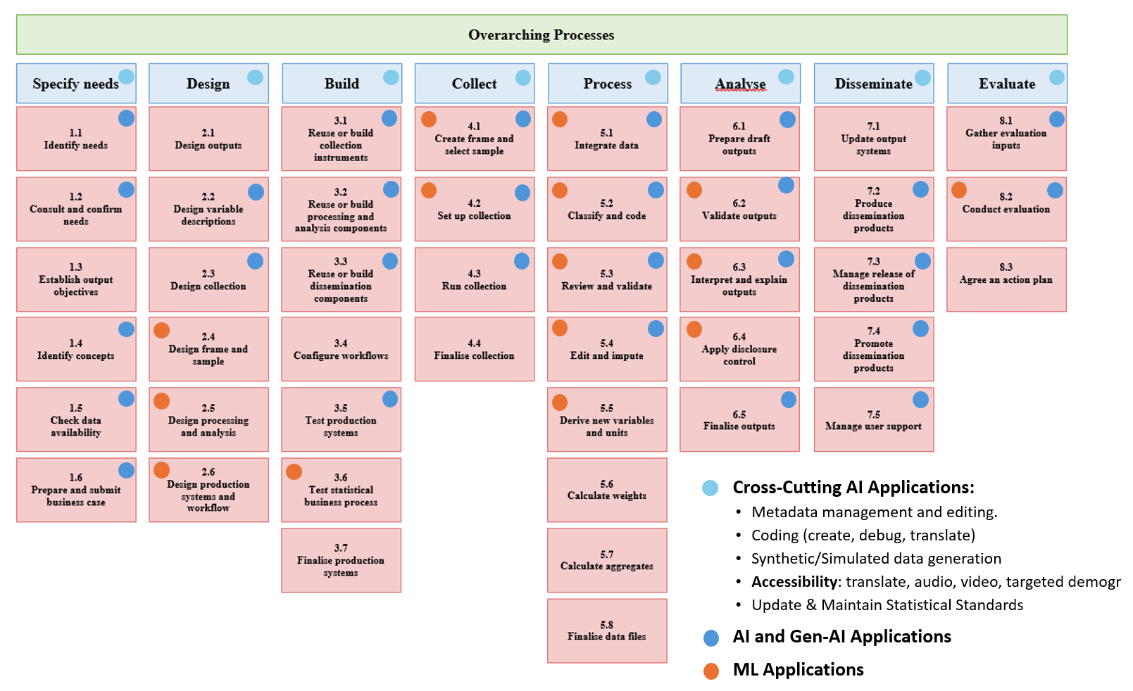
Mapping AI Applications and Opportunities to the GSBPM (StatCan version)

Slide 33
GSBPM Roadmap Business Development

Slide 34
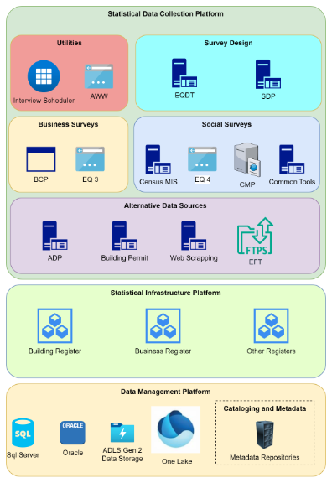
Business Development: Collection
Primary Data Collection – activity groups for business development:
Prototyping and exploration with business utilities
Once reached the operationalization stage – use corporate development to ensure operational rigor, repeatability, stability and support
Paradata research and analysis
Business process automation through established platforms - PowerApps, RPA etc.
AI-enabled solutions within corporate AI environments / platforms / tools
Secondary Data Collection (alternative data sources) – activity groups for business development:
Entry point for processing and analytical pipelines
Business development will follow patterns established for processing / analysis – including AI enablement

Slide 35



Business Development: Processing and Analysis Activity Groups – Non-IT
Description:
Develop AI models for classification and other purposes and perform advanced analytics
Develop methodologic algorithms and statistical models
High Code use cases, Machine Learning
Needs:
Develop data cleaning and transformation tools that handle inconsistencies across different data formats and sources
Leverage scalable computing resources that can quickly process large datasets
Tools for rapid iteration of models.
Data Science
Description:
Build and deploy data analytics solutions for oneself or others, following the Standard on Managing Data Analytics Solutions
Develop code, libraries, applications, etc. related to processing, modeling, visualization and analysis in statistical and administrative programs
Needs:
A low-code/no-code platform with intuitive interfaces for data manipulation, orchestration and visualization.
High Code - Modern R and Python development tools like RStudio and VS Code that allows debugging, unit testing, etc. to improve code quality and productivity
Business Development
Description:
Integrate data from all sources and generate accurate, timely reports, to provide reliable insights that guide strategic decisions
Run and support applications and pipeline built by others
Needs:
Data integration tools that can connect to both legacy and modern systems.
Create automated reporting pipelines that update data visualizations and dashboards in real-time.
Perform manual edits
Analysis

Slide 36

Business Development: Processing and Analysis Activity Groups – Corporate vs. Business Development
Mostly done by IT
Develop corporate solutions and enterprise grade platforms that are monitored, maintained, and supported through SLAs (Collection, Dissemination, the Zone, Fabric, Enterprise Dev, etc.)
Create enabling infrastructure (networking, AVDs, security monitoring, etc.)
Create web applications or highly complex systems / data analytics solutions using cloud technologies and cloud native platforms
Create applications or systems that impact multiple business areas, including mission critical programs
Follow corporate guidelines, policies, directives and SDLC practices
Follow SA&A process
Develop data analytics solutions (business logic) within IT supported, security assessed, AI-enabled production platforms (the Zone, Fabric) while following the Standard on Managing Data Analytics Solutions
Create data pipelines, R/Python scripts, modules and packages, visualizations and dashboards incl. use of AI methods
Create data edit / capture interfaces within security assessed platforms to allow for manual edits and overrides
Business process automation through established platforms - PowerApps, RPA etc.
Only allow access to what the user needs access to
Follow corporate guidelines, policies, directives and Statistical Reproducible Framework practices - Data Analytics Solution development process (e.g., no security assessment before putting developed business logic in production- attestation and automatic approvals)
Corporate Development
Business Development

Slide 37
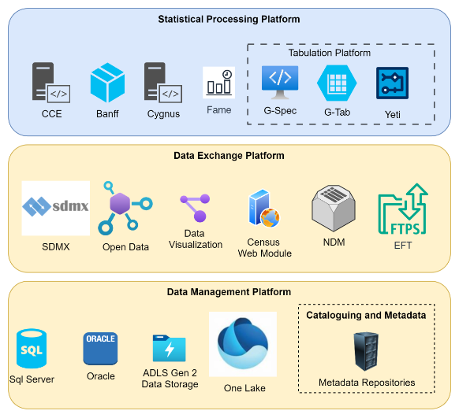
Business Development: Dissemination
Preparation of Dissemination outputs – activity groups for business development:
Dissemination vision calls for a set of rules what dissemination outputs should be created for the web-site – using corporate tools
Production of dissemination outputs will be the last step in the data pipelines – programs / operations will use activity groups for processing / analysis, incl. retrieval of external data for confrontation
Processing / analysis activity groups will also be used to produce custom tabulations - design, certification, and production
PUMP creation will be done with the use of corporate tools and business development will use processing / analysis activity groups if custom PUMF production is required
Disseminating outputs – for user consumption:
Programs / operations will use corporate platform / toolkits to create and post outputs on the website – e.g., Drupal toolkit to create and post pages; data visualization platforms such as PowerBI
Business process automation through established platforms - PowerApps, RPA etc.
Disseminating outputs – for AI consumption:
Use corporate platforms to publish statistical data in format expected by AI bots / search engines
Mission-critical dissemination processes – e.g., posting market moving data using embargo – will be done through platforms developed and maintained by IT

Slide 38



Statistics Canada— Your National Statistical Agency
Delivering insight through data for a better Canada

